Slide 1
Robot control via a head gesture-based user Interface
CSE 5359/6369 – SPECIAL TOPICS IN ADVANCED INTELLIGENT SYSTEMS
Final Project Presentation
Vishnu Gopal Rajan Rama Krishna Reddy

Slide 2
Introduction
Assistive robots could enable people with disabilities to reintegrate into working life. Namely, for people with motor impairments, unemployment is a serious problem.
For people suffering from tetraplegia, almost all activities requiring a user interaction are very tedious or even impossible without the help of assistants or assistive devices.
Hands-free assistive devices for tetraplegics can be controlled for example with speech interfaces, chin-joysticks, motion of the eyes, tongue or the head.

Slide 3
Introduction on Razor 9Dof IMU
The SparkFun 9DoF Razor IMU M0 is a SAMD21 microprocessor with an MPU-9250 9DoF sensor
This sensor is reprogrammable, multipurpose IMU (Inertial Measurement Unit).
The 9DoF Razor’s MPU-9250 features three 3-axis sensors---an accelerometer, gyroscope and magnetometer.
These give it the ability to sense linear acceleration, angular rotation velocity and magnetic field vectors.

Slide 4
Project Goals
For the Razor IMU to be configured in such a way it returns Yaw, Pitch and Roll of the head from the raw accelerometer, gyroscope and magnetometer readings.(Completed)
The Yaw, Pitch and Roll readings will be used to recognize certain pre defined gestures.(Completed)
Installation of Gazebo, Moveit!, Rviz and Universal Robot (UR5) to run the robot arm simulation.(Completed)
These gestures finally need to be translated to control the motion of the Assistive Robot’s end effector given the x,y,z coordinates.(Completed)
The Robot arm’s end effector must move to the coordinates inputted using head Gestures. (Completed)

Slide 5
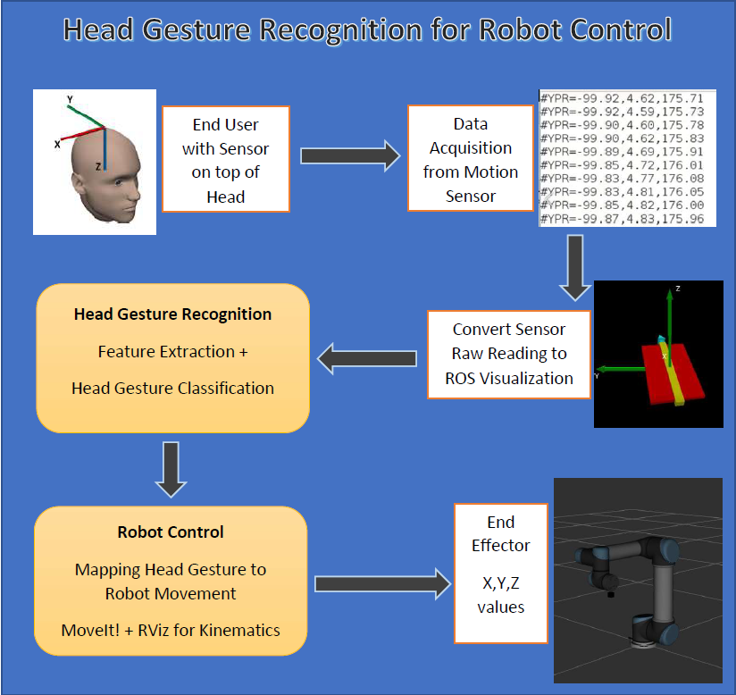
Conceptual Model

Slide 6
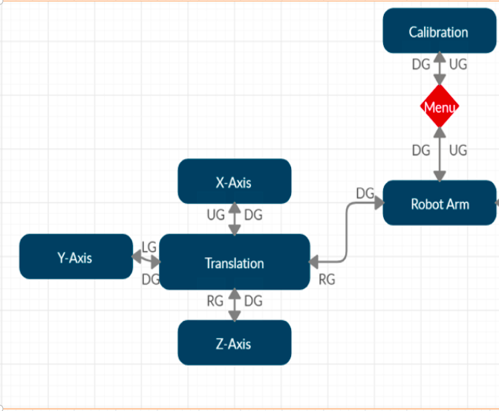
State Diagram

Slide 7
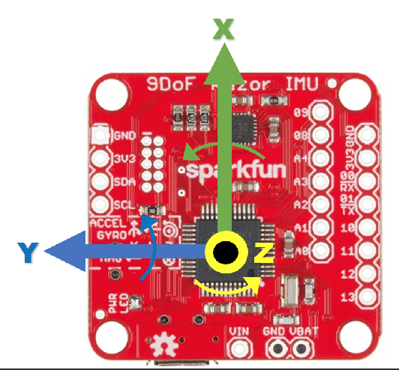
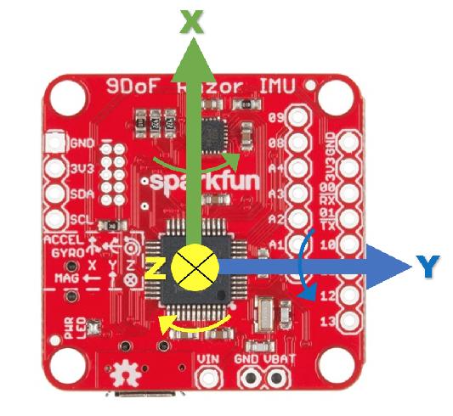
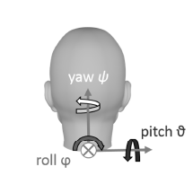
Coordinate frames of the Razor 9DoF Sensor
The razor_imu_9dof node transforms the Razor_AHRS measurements into the ROS coordinate frame.

Slide 8
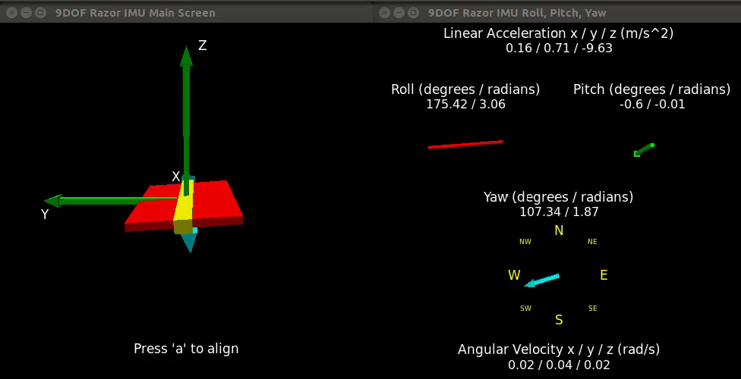
Methodology
Working with Razer IMU Sensor
Integrated the Razor IMU sensor with Arduino IDE, and the sensor returns the Accelerometer, Gyroscope and Magnetometer readings upon uploading the required Firmware.
Required Arduino support like ports and boards were installed.
The Yaw, Roll , Pitch values were then translated to ROS Visualization in order to help communicate with the ROS environment.

Slide 9
Methodology
Working with UR5 Simulation
Built a state diagram which traverses through the calibration and menu which enables us to edit Traversal values of robot arm.
Developed the code to recognize the Up, Down, Left and Right gestures using python.
Required installations included ROS Kinetic, Gazebo, MoveIt! and Rviz to run the simulation of UR5 robot arm simulation.
Created Moveit! Python interface program to translate gestures into end effector values for the robot arm to plan and execute.

Slide 10
Experimental Setup
Installation of software like Arduino, ROS Kinetic, Gazebo, Rviz, MoveIt!, UR5 robot simulation.
Setting up and uploading of required firmware for Razer IMU using Arduino to retrieve Yaw, Roll and Pitch.
Calibration of Accelerometer and Gyroscope for IMU sensor.
Conversion of raw readings to ROS Visualization.
Develop code to recognize Gestures using IMU and set x, y, z values using sensor.
Run simulated robot on Gazebo, Rviz and Moveit! and call the python interface code to set the x,y,z coordinates using Head Gestures.

Slide 11
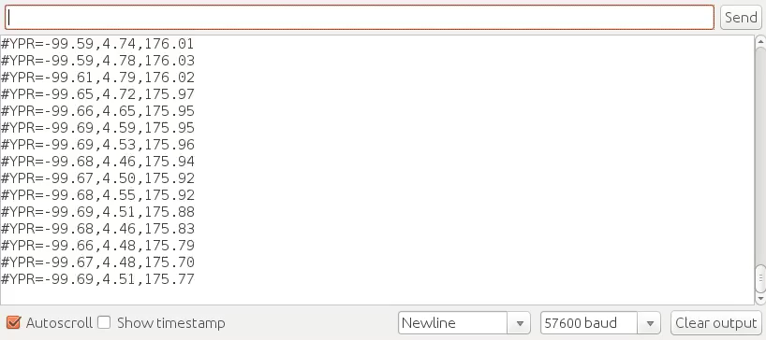
System Evaluation
Initial IMU Sensor Readings
Accelerometer Calibration values
accel x,y,z (min/max) = -5.00/-1.00 25.00/29.00 225.00/232.00
Gyroscope Calibration values
gyro x,y,z (current/average) = -29.00/-27.98 102.00/100.51 -5.00/-5.85

Slide 12
System Evaluation

Slide 13
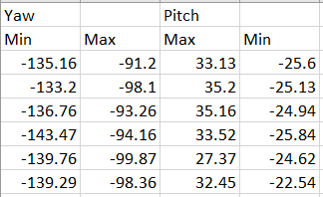
Data Acquired from Test subjects
This acquired data of maximum and minimum Yaw and Pitch readings are from the test subjects.
This data is used to set the range and also to recognize gestures.

Slide 14
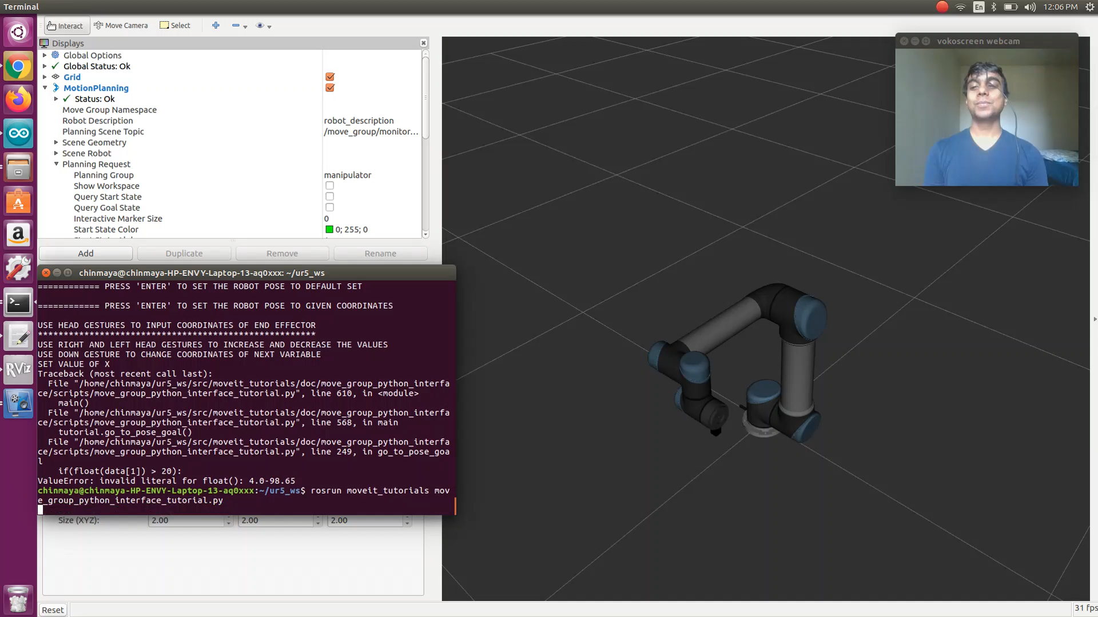
Project Demo 1

Slide 15
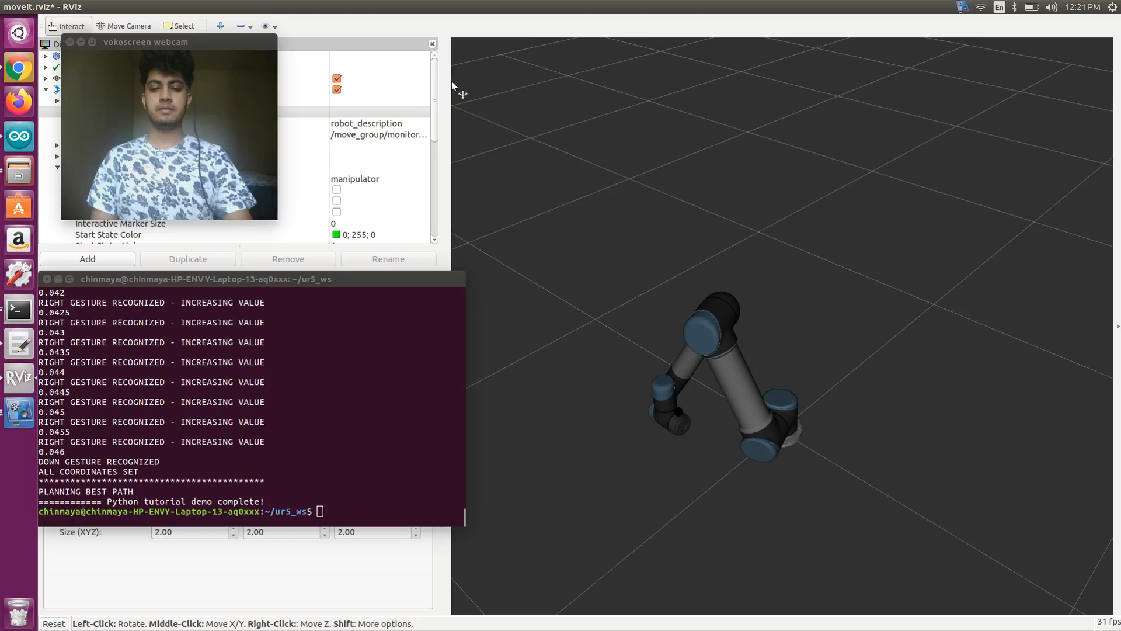
Project Demo 2

Slide 16
Role Designation
Vishnu
Installed ROS Kinetic, Gazebo, Rviz, MoveIt! And UR5 robot arm simulation.
Completed the Configuration and ROS Visualization of the Razor 9DoF IMU Sensor.
Developed code for Python interface to communicate with sensor and robot arm simulation.
Developed Code to translate head gestures into setting x,y,z values for end effector to move to.
Ram
Installed the Arduino on MacOs and retrieved the raw values from the sensor.
Modified the firmware to get yaw, pitch and roll values.
Build gesture recognition code to move through the state diagram.

Slide 17
Conclusions
End-user is able to perform “hands-free” control of the movement of the robot in Cartesian space using Head Gestures.
To evaluate this design, the user guided the robot through an simple translation task using head gestures.
This not only enables tetraplegic people but also helps them live an independent life.
Since, head movements are limited in this case another control feature like eye tracker can be added to increase the accuracy & speed of the system.

Slide 18
Future Work
This project can be modified into performing Pick-and-place tasks using head gestures.
This project also has the scope to enable work at an assembly line where the robot arm can pick and place items on the assembly line.
This project can also be improved upon to pick and place items which disabled people cannot do on their own.

Slide 19
Related work
Universal Robot (UR5) Pick and Place Simulation in ROS-Gazebo - https://github.com/lihuang3/ur5_ROS-Gazebo
Conversion of IMU Sensor raw readings into ROS visualization - http://wiki.ros.org/razor_imu_9dof
Move Group Python Interface for Franka Emika Panda - http://docs.ros.org/kinetic/api/moveit_tutorials/html/doc/move_group_python_interface/move_group_python_interface_tutorial.html
Universal Robot simulation on Gazebo - http://wiki.ros.org/ur_gazebo

Slide 20
References
[1] M.A. Haseeb, M. Kyrarini, S. Jiang, D. Ristic-Durrant, A. Gräser. 2018. Head Gesture-based Control for Assistive Robots. In Proceedings of 11th ACM International Conference on PErvasive Technologies Related to Assistive Environments (PETRA), Corfu Greece, June 2018 (Petra’18), 5 pages. https://doi.org/10.1145/3197768.3201574
[2] Rechy-Ramirez, E.J. and Hu, H., 2015. Bio-signal based control in assistive robots: a survey. Digital Communications and networks, 1(2), pp.85-101.
Universal Robot (UR5) Pick and Place Simulation in ROS-Gazebo - https://github.com/lihuang3/ur5_ROS-Gazebo
Move Group Python Interface for Franka Emika Panda - http://docs.ros.org/kinetic/api/moveit_tutorials/html/doc/move_group_python_interface/move_group_python_interface_tutorial.html
Universal Robot on Gazebo Simulation - https://github.com/UTNuclearRobotics/ur5_sim

Slide 21
Thank you

